Slide 1
أكـــــاديميــــة طــــويـــق
Artificial Intelligence Ethics

Slide 2
Explainable AI and its Techniques
By: Dr. Afshan Hashmi

Slide 3
Course Objectives:
Understand the importance of explainability in AI for trust, accountability, and adoption.
Differentiate between explainability (post-hoc) and interpretability (inherent simplicity).
Identify challenges in explaining complex models like deep learning and ensemble methods.
Compare local (individual predictions) and global (overall behavior) explanations.
Apply post-hoc explainability methods like LIME, SHAP, and Partial Dependence Plots.

Slide 4

Importance of Explainability
Why Explainability Matters:
Builds trust in AI systems by making their decisions transparent.
Ensures accountability for decisions made by AI models.
Facilitates adoption in regulated industries (e.g., healthcare, finance).
Helps identify and mitigate biases in AI models.
Example:
In healthcare, an AI model predicting diseases must explain why it flagged a patient as high-risk to gain the trust of doctors and patients.

Slide 5
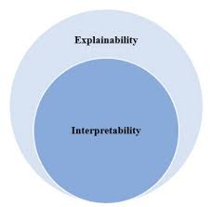
Difference Between Explainability and Interpretability
Explainability:
Refers to the ability to describe how a model makes decisions, often using post-hoc methods.
Example: Using SHAP values to explain a black-box model’s predictions.
Interpretability:
Refers to the inherent simplicity of a model, making its decisions easy to understand.
Example: A linear regression model is interpretable because its coefficients directly show the impact of features.

Slide 6
Challenges in Explaining Complex AI Models Deep Learning Models: Highly complex architectures (e.g., neural networks) make it hard to trace decision-making processes. Ensemble Methods: Models like Random Forests or Gradient Boosting combine multiple weak learners, making it difficult to explain the overall behavior. Trade-offs: Simpler models are more interpretable but may sacrifice accuracy. Complex models are more accurate but harder to explain.

Slide 7
Techniques for Explainable AI (XAI)
Local vs. Global Explanations
Local Explanations:
Explain individual predictions (e.g., why a specific loan application was rejected).
Example: LIME (Local Interpretable Model-agnostic Explanations).
Global Explanations:
Explain the overall behavior of the model (e.g., which features are most important across all predictions).
Example: Feature importance in Random Forests.

Slide 8


Advanced Tools and Libraries
SHAP: Unified framework for explainability.
LIME: Local interpretability for any model.
ELI5: Debugging and inspecting machine learning models.
Alibi: Advanced explainability for black-box models.

Slide 9
Post-Hoc Explainability Methods
LIME (Local Interpretable Model-agnostic Explanations)
Insights:
LIME approximates a complex model locally with a simpler model (e.g., linear regression).
It works by perturbing the input data and observing changes in predictions.
Limitations:
Sensitive to the choice of perturbation method.
May produce inconsistent explanations for similar inputs.

Slide 10
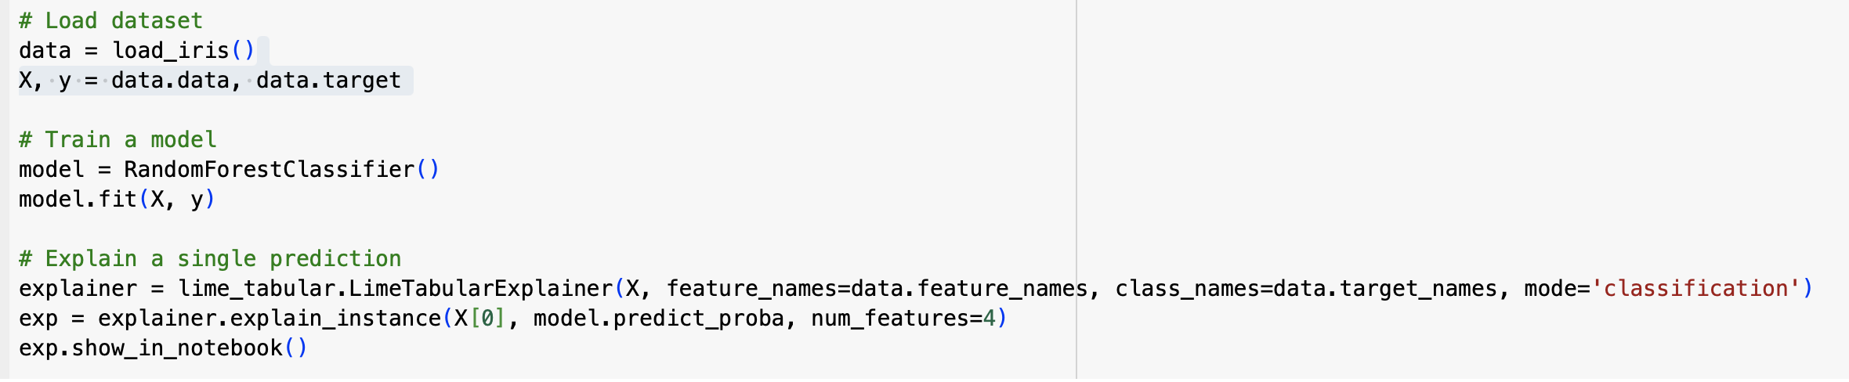
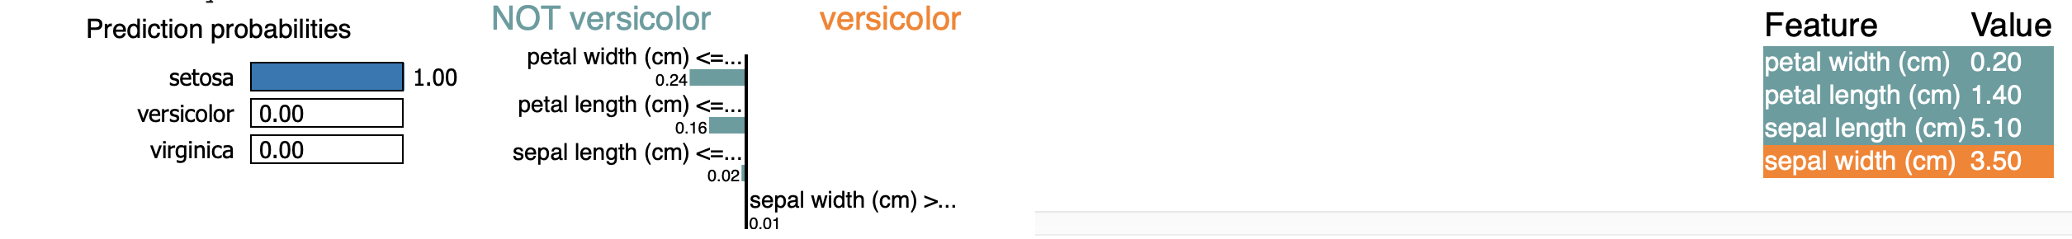
Post-Hoc Explainability Methods
LIME (Local Interpretable Model-agnostic Explanations)
Note : That LIME is able to explain the importance of each Feature responsible for a particular Predictions

Slide 11
SHAP (SHapley Additive exPlanations)
Insights:
SHAP values are based on cooperative game theory and provide a unified measure of feature importance.
They satisfy properties like efficiency, symmetry, and additivity.
Limitations:
Computationally expensive for large datasets or complex models.
May not capture interactions between features well.

Slide 12
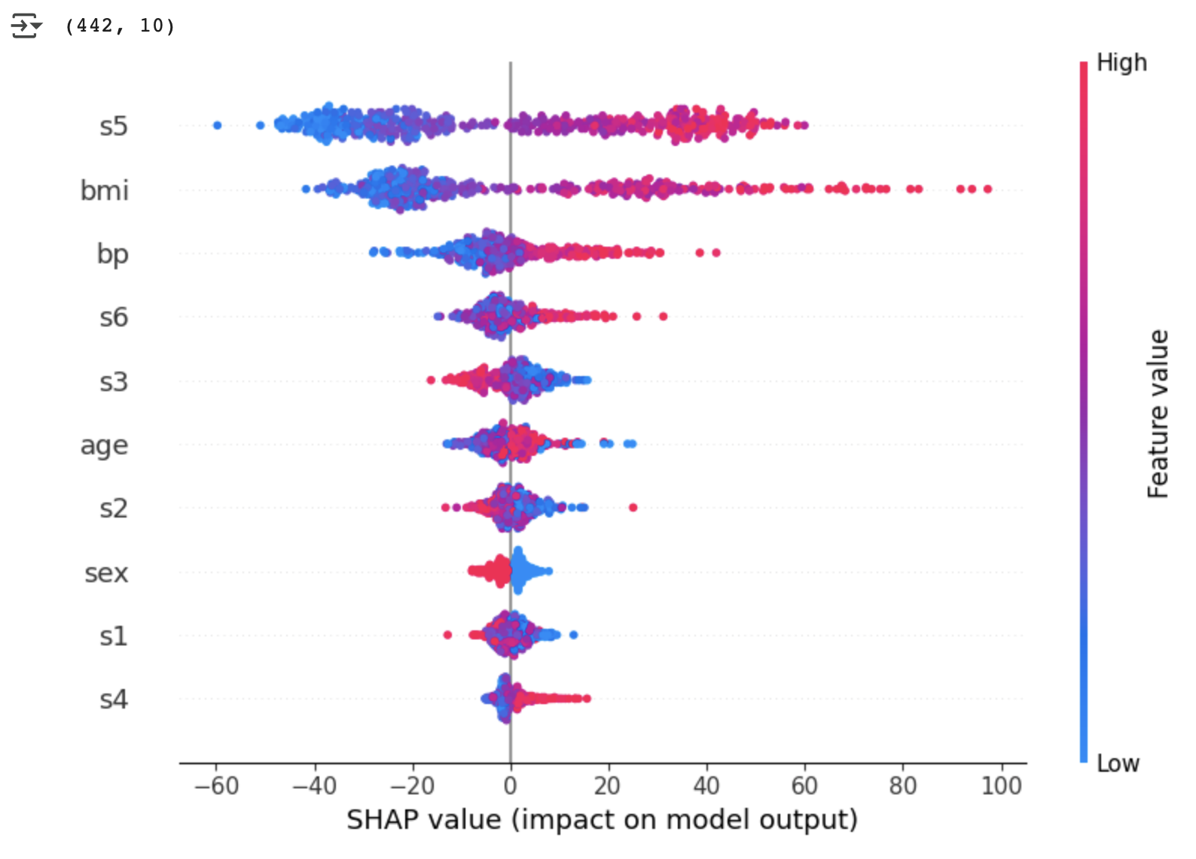
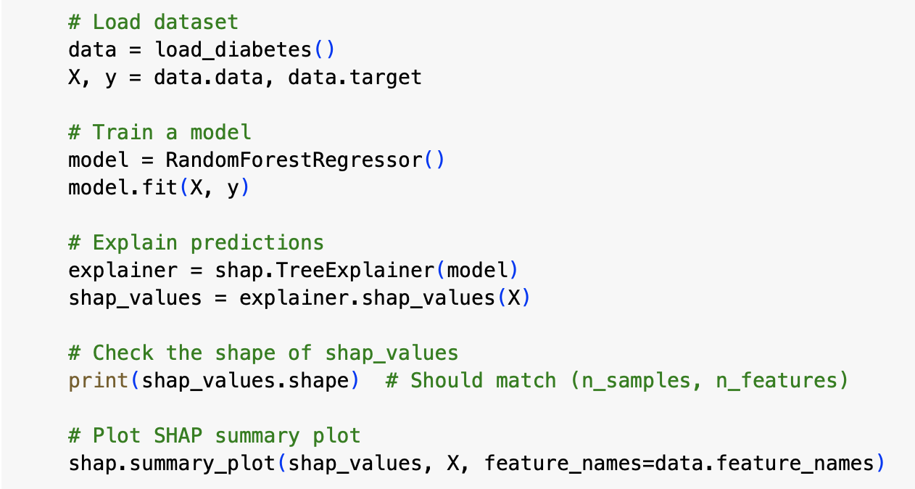
SHAP (SHapley Additive exPlanations)
Note: SHAP is representing each features value from low to high and positive to negative

Slide 13
Partial Dependence Plots (PDP)
Insights:
PDP shows the marginal effect of a feature on the predicted outcome.
It helps understand feature interactions and non-linear relationships
Limitations:
Assumes features are independent.
May be misleading if features are highly correlated.

Slide 14
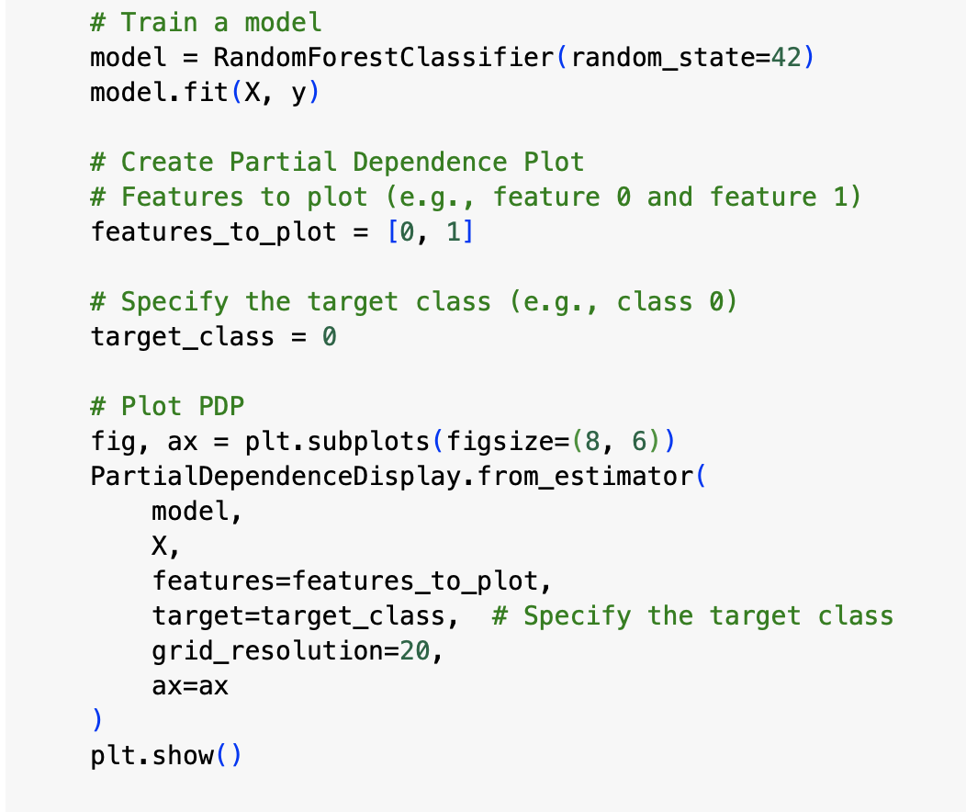
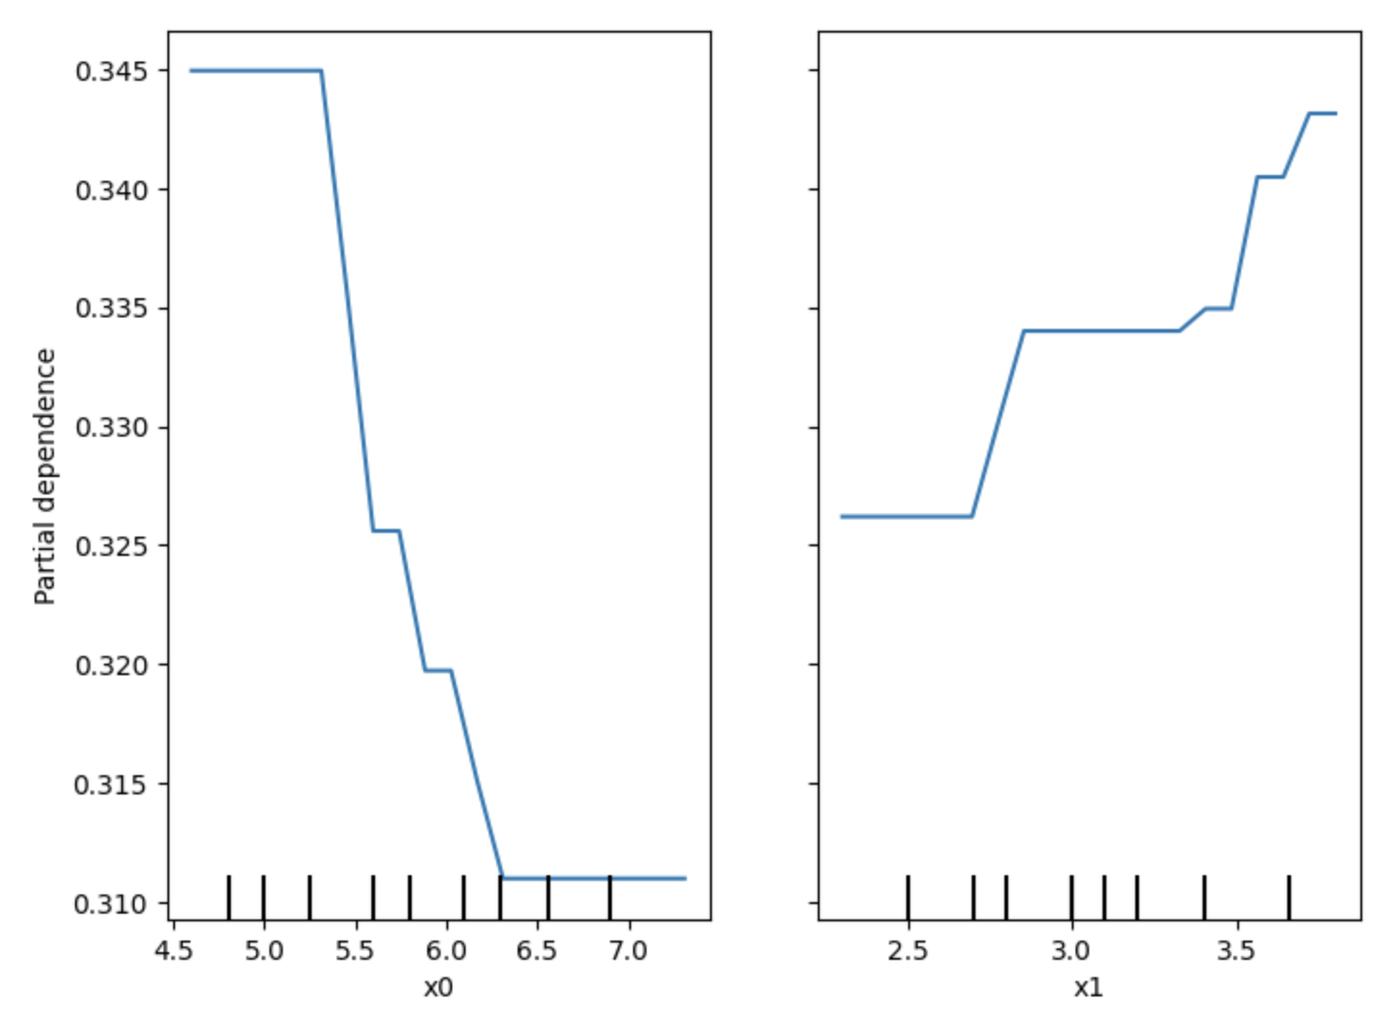
Partial Dependence Plots (PDP)

Slide 15

ELI5 (Explain Like I’m 5) - Debugging and Inspecting ML Models
ELI5 is a python package that is used to inspect ML classifiers and explain their predictions.
It is popularly used to debug algorithms such as sklearn regressors and classifiers, XGBoost, CatBoost, Keras, etc.
ELI5 helps inspect machine learning models by showing feature importance and explaining predictions in an interpretable way.
It works with scikit-learn, XGBoost, and deep learning models.

Slide 16
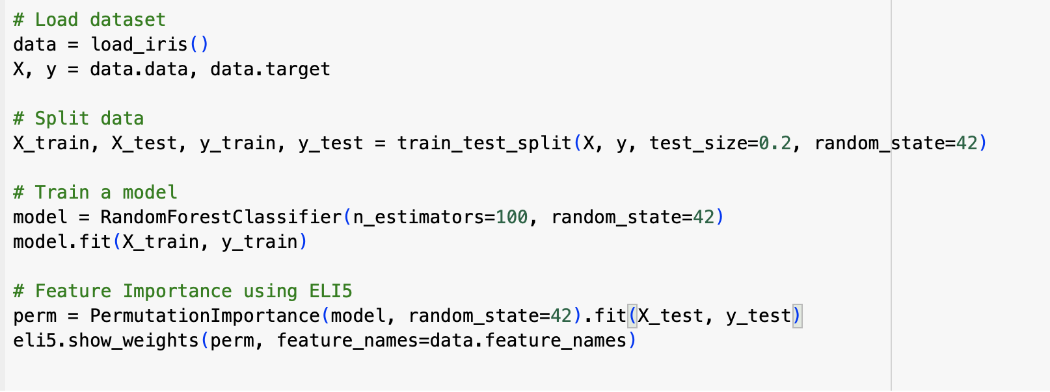
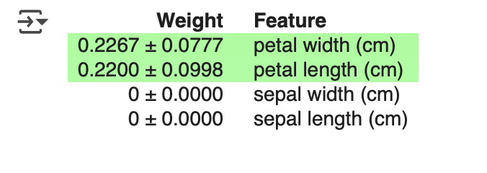
ELI5 (Explain Like I’m 5) - Debugging and Inspecting ML Models
Trains a RandomForestClassifier on the Iris dataset.
Uses Permutation Importance to determine how much each feature contributes to predictions.
Displays feature importance using eli5.show_weights().

Slide 17
Alibi - Explainability for Black-Box Models
Alibi Explain is a freely available Python toolkit designed to shed light on how machine learning models arrive at their predictions.
It provides a collection of advanced explainability techniques suitable for both classification and regression tasks.
These techniques can be applied regardless of whether you have detailed knowledge of the model's inner workings (black-box) or complete access (white-box).
The library handles diverse data formats, including tables, text, and images, and offers explanations at both the individual prediction level and the overall model behavior.
To ensure ease of use, Alibi Explain features a consistent programming interface.
The project emphasizes robust development practices, with comprehensive testing implemented to guarantee code reliability and algorithm accuracy.

Slide 18
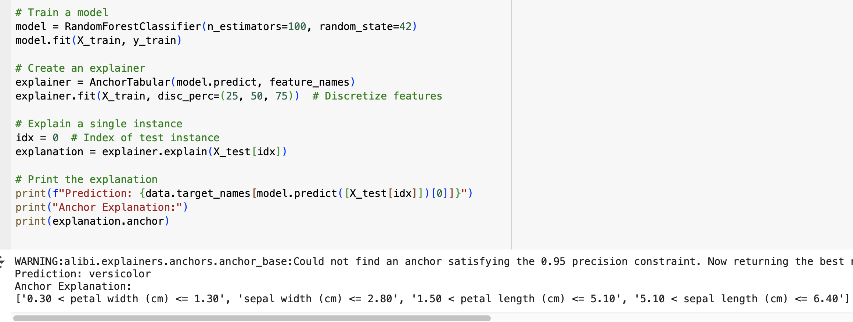
Alibi - Explainability for Black-Box Models
Uses AnchorTabular from Alibi to generate interpretable rule-based explanations.
Finds anchors (conditions in the input) that strongly influence the model’s prediction.
Prints a simple rule explaining why a decision was made.

Slide 19
Surrogate Models and Rule-Based Approximations
Surrogate Models:
Train a simpler model (e.g., decision tree) to approximate the behavior of a complex model.
Example: Use a decision tree to explain a neural network’s predictions.
Rule-Based Approximations:
Extract human-readable rules from a model (e.g., using RuleFit or SkopeRules).
Example: "If age > 30 and income < $50,000, then reject loan application."

Slide 20
Advanced Applications of XAI
3.1 Model Debugging
Use SHAP or LIME to identify why a model is making incorrect predictions.
Example: Diagnosing why a medical diagnosis model is failing for certain patient groups.
3.2 Feature Engineering
Use feature importance from SHAP or PDP to identify the most impactful features.
Example: Removing irrelevant features to improve model performance.
3.3 Bias Detection
Use XAI techniques to detect and mitigate biases in AI models.
Example: Identifying gender bias in a hiring algorithm.

Slide 21
Hands-On Activity
Activity: Explain a Model Using SHAP and LIME
Train a complex model (e.g., Random Forest or Neural Network) on a dataset (e.g., Iris or Titanic).
Use SHAP to explain global feature importance.
Use LIME to explain individual predictions.
Compare the explanations and discuss their strengths and limitations.

Slide 22
Summary
Explainability is crucial for building trust, ensuring accountability, and facilitating adoption of AI systems.
Techniques like LIME, SHAP, and PDP provide insights into model behavior at both local and global levels.
Surrogate models and rule-based approximations simplify complex models for better understanding.

Slide 23
Practice with Google COLAB
Click here
https://colab.research.google.com/drive/14ZWbmJ4GeT4PPLjuz3kLV2tIWoMVz0z-

Slide 24

















الشراكات العالمية

Slide 25
شــــــكــــرًا لكــــــم
THANK YOU

